Slide 1





Cataloging and Observing Active Galactic Nuclei
Madelyn Hart
Dr. Scott Barrows

Slide 2
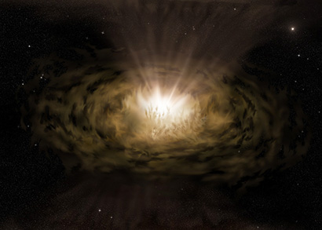
What are Active Galactic Nuclei (AGN)?
Supermassive Black Holes (SMBH) in the Center of a Galaxy
  Type 1 (broad lined)
  Type 2 (narrow lined)
Growth
  Accretion of dust and gas in galaxy
  Greater growth rates accumulate greater dust and gas
Detection
  Mid Infrared Color Light Detection
    Not affected by gas and dust
  Multi-wavelength photometry
    Compared to Wide-field Infrared Survey Explorer (WISE) Source

Slide 3
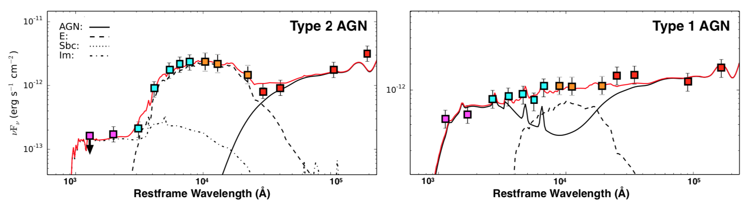
Spectral Energy Distributions and Wavelength Filters
Spectral Energy Distribution
  Red = WISE
  Orange = 2-Mass
  Purple = Galex
"A Catalog WISE Active Galactic Nuclei Host Galaxies and Properties." R. Scott Barrows, Julia M. Comerford, Daniel Stern, Roberto J. Assef, and Madelyn Hart. 2020. To be submitted to the Astrophysical Journal

Slide 4
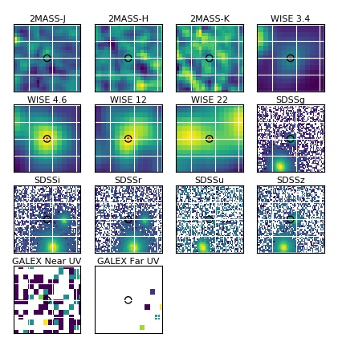
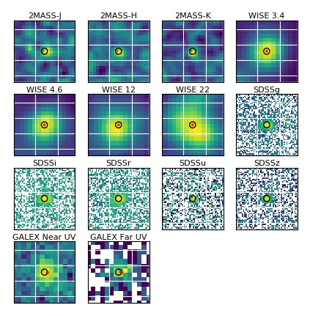
Detection Wavelength Filters
ID115 (0.0067213,19.4291554) Multi-wavelength photometry
ID130 (0.0074743,0.8896771) Multi-wavelength photometry

Slide 5
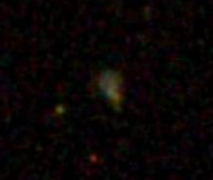

Mergers
Searching for Merging Galaxy Pairs
Interest
  AGN in merging galaxies will eventually merge
  AGN mergers produce peak light radiation
  Properties can be observed and compared to theoretical and predicted measurements/characteristics
Detection
  Data viewed individually in SDSS images
  Mergers with Companions

Slide 6
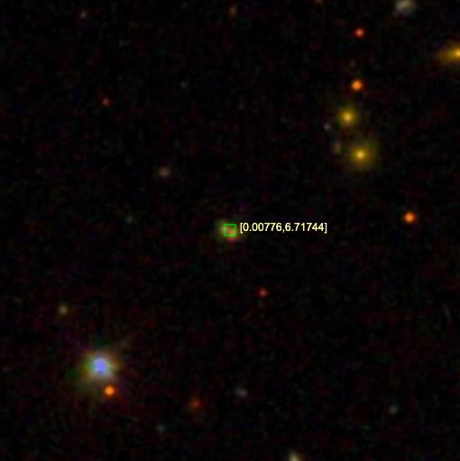
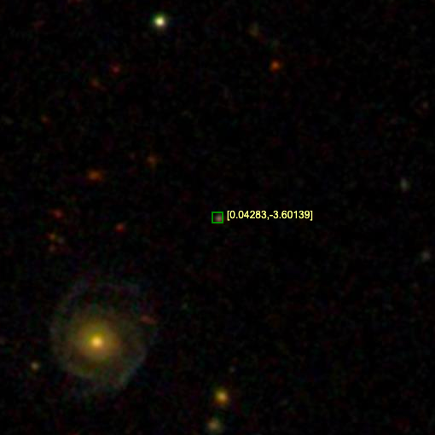

Mergers
ID133 (0.0077602,6.7174417) Clear merger of two identified galaxies.
ID780 (0.0428297,-3.6013858) Though not a galaxy merger, a defined spiral galaxy can be seen in the lower left corner.

Slide 7
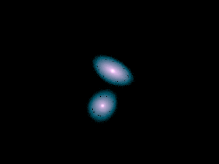
Further Results
Next Steps
Compare Properties
  Separation between AGN
  Red Shift
  Luminosity
  Star Formation Rate
  Etc.
Look for Patterns

Slide 8
Questions
Acknowledgements

